Slide 1
Mandu
team : 나희지, 변동건, 심지영, 하수연

Slide 2
List
Motive
Characteristic
Function
Q&A

Slide 3
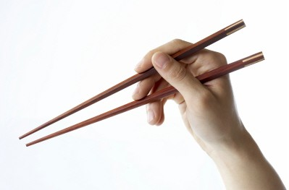

1. Motive
The life of a college students.
Students | Dumpling
The stress of college life | Dumpling stuffing
Precarious mind | Dumpling skin
Problem | Chopsticks

Slide 4
2. Characteristic
Time recording game
Many character
Item
The familiar theme

Slide 5
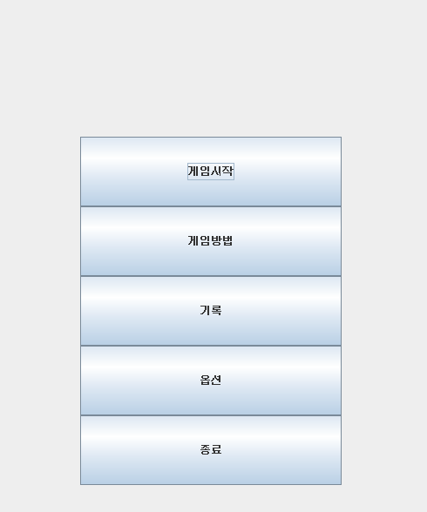
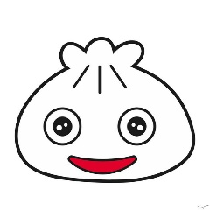
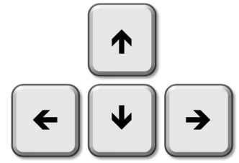

3. Function
● Title screen
OR

Slide 6
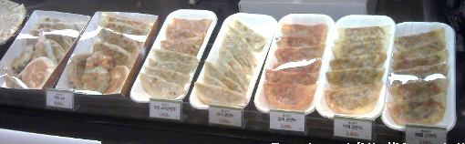
3. Function
● Character choice
Game start

Slide 7
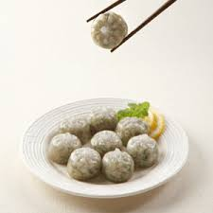
3. Function
● Game screen
DIE
Only

Slide 8

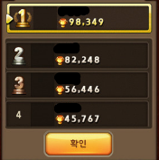

3. Function
● Game screen

Slide 9

3. Function
● Game screen

Slide 10
Q&A

Slide 11

Thank You

